Slide 1
Convolutional Encoding Viterbi Decoding
WES269 Winter 2022
Lecture 2

Slide 2
Interesting quote of the day
"First, computer software and hardware are the most complex and rapidly developing intellectual creations of modem man."
-- p. iii, Internet and Computer Law, P. B. Maggs, J. T. Soma, and J. A. Sprowl, 2001
... but you already knew that :)

Slide 3
Credits: Today’s lecture is based on:
A Tutorial on Convolutional Coding with Viterbi Decoding
Chip Fleming
Spectrum Applications

Slide 4
Origin of Viterbi Decoding
Andrew J. Viterbi, "Error Bounds for Convolutional Codes and an Asymptotically Optimum Decoding Algorithm," IEEE Transactions on Information Theory, Volume IT-13, pp. 260-269, April 1967.
Viterbi is a founder of Qualcomm.

Slide 5
Terminology
k number of message symbols
n number of codeword symbols
r rate = k/n
m number of encoding cycles an input symbol is stored
K number of input symbols used by encoder to compute each output symbol (decoding time exponentially dependent on K)

Slide 6
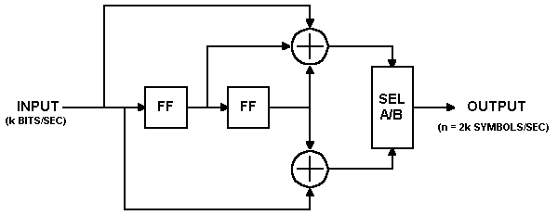
Convolutional Encoder
output upper input
followed by lower input
flip flop
(stores one bit)
n = 2*k, r = ½, K = 3, m = 2 (why?)

Slide 7
Encoding Example
FFs are dly[1] and dly[2] in my simulation
Both flip flops set to 0 initially.
Input: 010111001010001
Output: 00 11 10 00 01 10 01 11 11 10 00 10 11 00 11
Flush encoder by clocking m = 2 times with 0 inputs.

Slide 8
insert Verilog/ModelSim demo here
Note 2:1 rate change
Suitable for QPSK, for example
Show 2 versions of ModelSim:
one bit in, two bits out at CLK rate
one bit out at CLK rate, one bit in every 2 clocks
both produce the same result
Now let's decode

Slide 9
decode content
Viterbi decoding for convolutional codes
Hidden Markov models
The hidden model is the transmitter's convolutional encoder and its uncorrupted data stream.
We are trying to revers-engineer this sequence by observing a possibly corrupted version of the transmitted data stream.
With contributions taken from Dan Durafsky

Slide 10
Problem formulation
noise
information
x
n
Finite State Machine
observation
y = x + n
What is the best estimate for the information given the observation?
Maximum Likelihood receiver:
max P( Y | X ) = max P( X+N | X ) = max P( N )
for independent transmissions = max Π_{i=1,L} P( N_{i} )
≡ minimum weight noise sequence

Slide 11
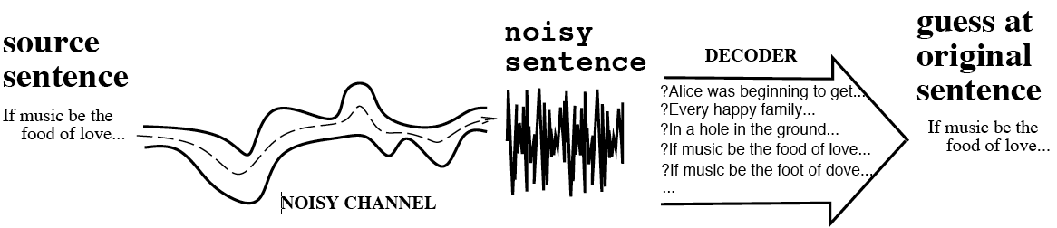
The Noisy Channel Model
Search through space of all possible sentences.
uh ... that's a kinda big space ...
Pick the one that is most probably the given the waveform.

Slide 12
characteristics
Viterbi algorithm ("VA" block) common in high-speed modems.
key building block of modern information infrastructure
Summary:
VA finds a path through any Markov graph
M. graph = sequence of states governed by a Markov chain.
Sample practical applications:
convolutional decoding and channel trellis decoding.
fading communication channels,
partial response channels in recording systems,
optical character recognition,
voice recognition.
DNA sequence analysis

Slide 13
Illustration of the algorithm
Walk through states (st *). Figure of merit = low diff. = high correlation between
observed data and data output stream from each sequence of states.
st 1 0.7 st 2
0.5 0.2
IEM 0.5 1.2 UNI
0.8 0.2
st 3 st 4
0.8
0.5
1.2
1.2
0.8
1.0
survivor

Slide 14
Key idea
F
A
B
C
D
E
Best path from A to C = best of
- the path A-F-C
- best path A to B + best path from B to C
- the path via D does not influence the best way from B to C

Slide 15
Application to convolutional code
Info code code + noise estimate
encoder
VD
channel
c1
c1⊕ n1
n1
I
binary noise sequences
P(n1=1)=P(n2=1) = p
delay
n2
c2⊕ n2
c2
find sequence I‘ that corresponds to code sequence ( c1, c2 ) at minimum distance from (r1,r2) = (c1 ⊕ n1, c2 ⊕ n2)

Slide 16
Use encoder state space
I
delay
c2
00
00
00
00
State 0
11
11
11
11
•••
10
10
10
10
State 1
01
01
01
01
Time 0 1 2 3

Slide 17
Encoder output 00 11 10 00
00
00
00
00
State 0
11
11
11
11
•••
10
10
10
State 1
01
01
01
channel output 00 10 10 00
00
0
00
1
00
1
00
1
State 0
best
11
11
11
11
•••
10
10
10
State 1
2
01
1
01
2
01
3

Slide 18
Viterbi Decoder action
Maximum Likelihood receiver: find ( c1, c2 ) that maximizes
Probability ( r1, r2 | c1, c2 ) = Prob ( c1 ⊕ n1, c2 ⊕ n2 | c1, c2 ) =
= Prob ( n1, n2 )
= minimum # noise digits equal to 1

Slide 19
Distance Properties of Conv. Codes
Def: The free distance, d_{free}, = minimum Hamming distance between any two code sequences.
Criteria for good convolutional codes:
1. Large free distance, d_{free}.
2. Small numer of information bits = 1 in sequences with low Hamming weight
There is no known constructive way of designing a convolutional code of given distance properties.
However, a given code can be analyzed to find its distance properties.

Slide 20
Distance Prop. of Convolutional Codes (cont’d)
Convolutional codes are linear =>
Hamming distance between any two code sequences corresponds to the Hamming distance between the all-zero code sequence and any nonzero code sequence.
The nonzero sequence of minimum Hamming weight diverges from the all-zero path at some point and remerges with the all-zero path at some later point.
Convolutional Codes 20

Slide 21
Distance Properties: Illustration
sequence 2: Hamming weight = 5, d_{inf} = 1
sequence 3: Hamming weight = 7, d_{inf} = 3.
seq 2: one wrong move
seq 3: three wrong moves

Slide 22
Modified State Diagram (cont’d)
Path from (00) to (00) is denoted by
D^{i} (weight)
L^{j} (length)
N^{k} (# info 1‘s)

Slide 23
Transfer Function
The transfer function T(D,L,N)

Slide 24
Transfer Function (cont’d)
Performing long division:
T(D,L,N) = D⁵L³N + D⁶L⁴N² + D⁶L⁵N² + D⁷L⁵N³ + ….
If want Hamming distance of the code only,
set N = 1 and L = 1 to get the distance transfer function:
T (D) = D⁵ + 2D⁶ + 4D⁷ + …
There is one code sequence of weight 5. Therefore d_{free}=5.
There are two code sequences of weight 6,
four code sequences of weight 7, ….

Slide 25
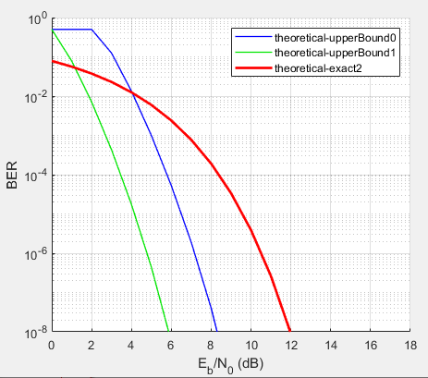
red = no FEC; blue = hard decision Viterbi; green = soft decision Viterbi
This is for a
common (171,133)
trellis
Note bit error rate = 5*10⁻¹ is as bad as it gets

Slide 26
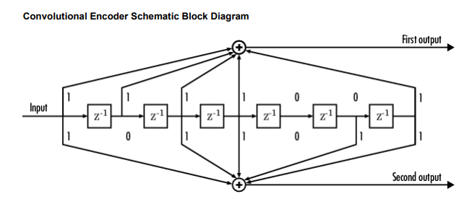
(001)(111)(001) = 171 octal
(001)(011)(011) = 133 octal
Same rate as our earlier 3-tap example

Slide 27
So why the longer constraint length?
It's cheap enough at the encoder, but a pain in the decoder.
Longer constraint length => greater potential distance between output sequences.
A given error or group of errors is less likely to be mis-corrected.

Slide 28
performance
correct
node
incorrect
The event error probability = probability that the decoder selects a code sequence that was not transmitted
For two codewords the Pairwise Error Probability is
The upperbound for the event error probability is given by

Slide 29
performance
using the T(D,N,L), formulate this as
The bit error rate (not probability) is

Slide 30
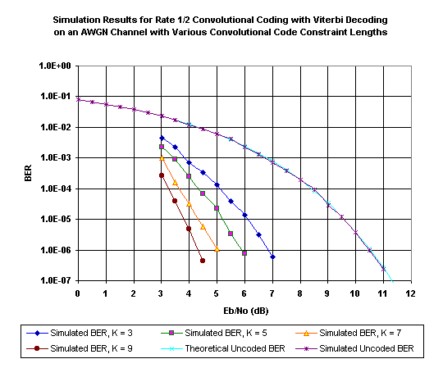
The constraint length of the ½ convolutional code: k = 1 + # memory elements
Complexity Viterbi decoding: proportional to 2^{K} (number of different states)

Slide 31
Note with any error correction scheme there is a minimum Eb/No, below which the error "correction" scheme may make things worse.
Simulink demo

Slide 32
PERFORMANCE:
theoretical uncoded BER given by
where Eb is the energy per information bit
for the uncoded channel, E_{s}/N₀ = E_{b}/N₀, since there is one channel symbol per bit.
for the coded channel with rate k/n, nE_{s} = kE_{b} and thus E_{s} = E_{b} k/n
The loss in the signal to noise ratio is thus -10log₁₀ k/n dB
rate ½ codes => lose 3 dB SNR at the receiver

Slide 33
metric (not Imperial or English :) )
We determine the Hamming distance between the received symbols and the code symbols
d(x, y) = metric
Properties:
d(x, y) ≥ 0 (non-negativity)
d(x, y) = 0 if and only if x = y (identity)
d(x, y) = d(y, x) (symmetry)
d(x, z) ≤ d(x, y) + d(y, z) (triangle inequality).

Slide 34
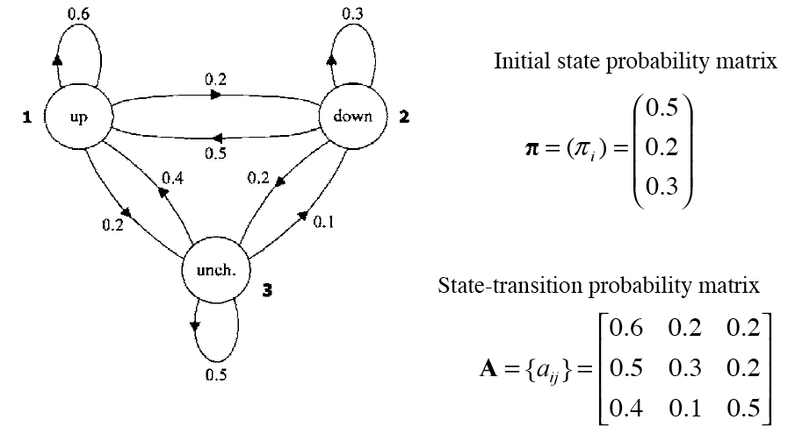
Markov model for Dow Jones (stock prices)
Figure from Huang et al, via

Slide 35
Markov Model for Dow Jones
What is the probability of 5 consecutive up days?
Sequence is up-up-up-up-up
I.e., state sequence is 1-1-1-1-1
P(1,1,1,1,1) =
π₁a₁₁a₁₁a₁₁a₁₁ = 0.5 x (0.6)⁴ = 0.0648

Slide 36
Application to Hidden Markov Models
Definition of HMM: inite set of states, each of which is associated with a probability distribution.
transitions among the states are governed by a set of probabilities called transition probabilities. ome or observation can be generated, according to the associated probability distribution.
Only the outcome, not the state, is visible to an external observer
States are ``hidden'' to the outside; hence the name Hidden Markov Model.
EXAMPLE APPLICATION: speech recognition and synthesis

Slide 37
Example HMM for Dow Jones (from Huang et al.)
0.7
0.1
0.2
0.1
0.6
0.3
0.2
0.6
1
2
0.3
0.5
0.4
0.2
0.2
0.1
0.5
0.2 = initial state probability
0.3
P(up)
P(down) =
P(no-change)
3
0.3
0.3
0.4
0.6
0.5
0.4
0.2
0.3
0.1
0.2
0.2 transition matrix
0.5
0.5

Slide 38
Calculate Probability ( observation | model )
Probability, UP, UP, UP, ***
Trellis:
0.7
0.1
0.2
0.35*0.6*0.7
0.179*0.6*0.7
0.5
0.35
0.179
0.02*0.5*0.7
0.008*0.5*0.7
0.09*0.4*0.7
0.1
0.6
0.3
0.2
0.02
0.008
0.036*0.4*0.7
0.35*0.2*0.3
P(up)
P(down)
P(no-change)
0.3
0.3
0.4
0.02*0.2*0.3
0.3
0.09
0.036
0.09*0.5*0.3
0.6
0.5
0.4
0.2
0.3
0.1
0.2
0.2 transition matrix
0.5
0.46
0.223
add probabilities !

Slide 39
Calculate Probability ( observation | model )
Note: The given algorithm calculates

Slide 40
Calculate max_{S} Prob( up, up, up and state sequence S )
Observation is (UP, UP, UP, *** )
0.7
0.1
0.2
0.35*0.6*0.7
0.147*0.6*0.7
best
0.5
0.35
0.147
0.02*0.5*0.7
0.007*0.5*0.7
0.09*0.4*0.7
0.1
0.6
0.3
0.2
0.02
0.007
0.021*0.4*0.7
0.35*0.2*0.3
P(up)
P(down)
P(no-change)
0.3
0.3
0.4
0.02*0.2*0.3
0.3
0.09
0.021
0.09*0.5*0.3
0.6
0.5
0.4
0.2
0.3
0.1
0.2
0.2 transition matrix
0.5
Select highest probability !

Slide 41
Calculate max_{S} Prob( up, up, up and state sequence S )
Note: The given algorithm calculates
Hence, we find
the most likely state sequence given the observation

Slide 42
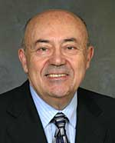
06 June 2005 08:00 AM (GMT -05:00)
(From The Institute print edition) Viterbi Receives Franklin Medal
Send Link
Printer Friendly
Andrew Viterbi
As a youth, Life Fellow Andrew Viterbi never envisioned that he’d create an algorithm used in every cellphone or that he would cofound Qualcomm, a Fortune 500 company that is a worldwide leader in wireless technology.
Viterbi came up with the idea for that algorithm while he was an engineering professor at the University of California at Los Angeles (UCLA) and then at the University of California at San Diego (UCSD), in the 1960s. Today, the algorithm is used in digital cellphones and satellite receivers to transmit messages so they won’t be lost in noise. The result is a clear undamaged message thanks to a process called error correction coding. This algorithm is currently used in most cellphones.
“The algorithm was originally created for improving communication from space by being able to operate with a weak signal but today it has a multitude of applications,” Viterbi says.
For the algorithm, which carries his name, he was awarded this year’s Benjamin Franklin Medal in electrical engineering by the Franklin Institute in Philadelphia, one of the United States’ oldest centers of science education and development. The institute serves the public through its museum, outreach programs, and curatorial work. The medal, which Viterbi received in April, recognizes individuals who have benefited humanity, advanced science, and deepened the understanding of the universe. It also honors contributions in life sciences, physics, earth and environmental sciences, and computer and cognitive sciences.
Qualcomm wasn’t the first company Viterbi started. In the late 1960s, he and some professors from UCLA and UCSD founded Linkabit, which developed a video scrambling system called Videocipher for the fledgling cable network Home Box Office. The Videocipher encrypts a video signal so hackers who haven’t paid for the HBO service can’t obtain it.
Viterbi, who immigrated to the United States as a four-year-old refugee from facist Italy, left Linkabit to help start Qualcomm in 1985. One of the company’s first successes was OmniTracs, a two-way satellite communication system used by truckers to communicate from the road with their home offices. The system involves signal processing and an antenna with a directional control that moves as the truck moves so the antenna always faces the satellite. OmniTracs today is the transportation industry’s largest satellite-based commercial mobile system.
Another successful venture for the company was the creation of code-division multiple access (CDMA), which was introduced commercially in 1995 in cellphones and is still big today. CDMA is a “spread-spectrum” technology—which means it allows many users to occupy the same time and frequency allocations in a band or space. It assigns unique codes to each communication to differentiate it from others in the same spectrum.
Although Viterbi retired from Qualcomm as vice chairman and chief technical officer in 2000, he still keeps busy as the president of the Viterbi Group, a private investment company specializing in imaging technologies and biotechnology. He’s also professor emeritus of electrical engineering systems at UCSD and distinguished visiting professor at Technion-Israel Institute of Technology in Technion City, Haifa. In March he and his wife donated US $52 million to the University of Southern California in Los Angeles, the largest amount the school ever received from a single donor.
To honor his generosity, USC renamed its engineering school the Andrew and Erna Viterbi School of Engineering. It is one of four in the nation to house two active National Science Foundation–supported engineering research centers: the Integrated Media Systems Center (which focuses on multimedia and Internet research) and the Biomimetic Research Center (which studies the use of technology to mimic biological systems).

Slide 43
Viterbi Decoding Applications
decoding trellis-coded modulation in modems
most common FEC technique used in space communications (r = ½, K = 7)
usually implemented as serial concatenated (nested) block and convolutional coding – first Reed-Solomon, then convolutional; opposite order on decode
Turbo codes are a parallel-concatenated convolutional coding technique
Use soft output Viterbi in feedback loop
actually reasonably named

Slide 44
State Transition and Output Tables
 | Next State, if
Current State | Input = 0: | Input = 1:
00 | 00 | 10
01 | 00 | 10
10 | 01 | 11
11 | 01 | 11
 | Output Symbols, if
Current State | Input = 0: | Input = 1:
00 | 00 | 11
01 | 11 | 00
10 | 10 | 01
11 | 01 | 10
State transition table
Output table
2^{m} rows

Slide 45
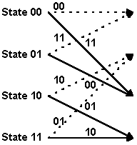
State Transitions
input symbol is 1
input symbol is 0
arcs labeled with output symbols

Slide 46
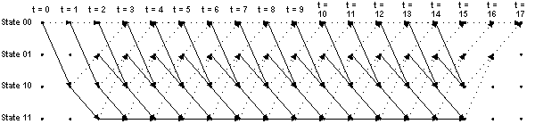
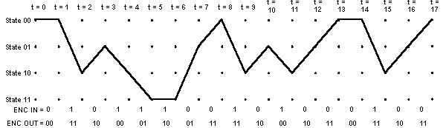
Trellis

Slide 47
Trellis and trajectory
Trellis repeats at every position
Trajectory goes upward for data input 0, downward for 1

Slide 48
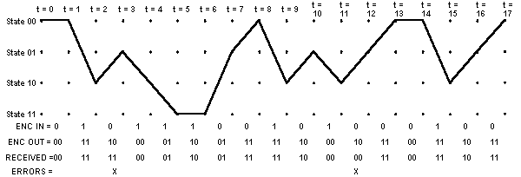
Oops! Errors in received bits!

Slide 49
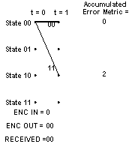
Viterbi Decoding - Accumulated Error Metric
Trying to find the input sequence whose corresponding output matches the received output as closely as possible.
(use Hamming distance in our example)

Slide 50
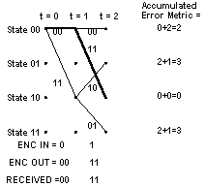
Accumulated Error Metric

Slide 51
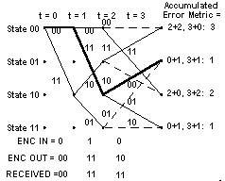
Decoder Trellis

Slide 52
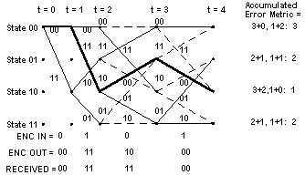
Decoder Trellis

Slide 53
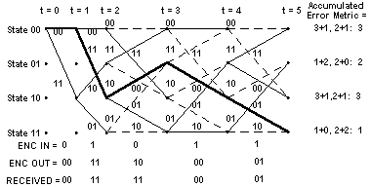
Decoder Trellis

Slide 54
So many paths, so little time
As you can easily see, there are may possible paths through the trellis, even though there are only four states and two possible data input values.
The key is in the pruning, retaining only the most promising paths and discarding the ones with the largest errors.

Slide 55

Final Decoder Trellis

Slide 56
Accumulated Error Metric over Time
t = | 0 | 1 | 2 | 3 | 4 | 5 | 6 | 7 | 8 | 9 | 10 | 11 | 12 | 13 | 14 | 15 | 16 | 17
State 00₂ |  | 0 | 2 | 3 | 3 | 3 | 3 | 4 | 1 | 3 | 4 | 3 | 3 | 2 | 2 | 4 | 5 | 2
State 01₂ |  |  | 3 | 1 | 2 | 2 | 3 | 1 | 4 | 4 | 1 | 4 | 2 | 3 | 4 | 4 | 2
State 10₂ |  | 2 | 0 | 2 | 1 | 3 | 3 | 4 | 3 | 1 | 4 | 1 | 4 | 3 | 3 | 2
State 11₂ |  |  | 3 | 1 | 2 | 1 | 1 | 3 | 4 | 4 | 3 | 4 | 2 | 3 | 4 | 4
Last two inputs known to be zero.

Slide 57
Surviving Predecessor States
t = | 0 | 1 | 2 | 3 | 4 | 5 | 6 | 7 | 8 | 9 | 10 | 11 | 12 | 13 | 14 | 15 | 16 | 17
State 00₂ | 00 | 00 | 00 | 01 | 00 | 01 | 01 | 00 | 01 | 00 | 00 | 01 | 00 | 01 | 00 | 00 | 00 | 01
State 01₂ | 00 | 00 | 10 | 10 | 11 | 11 | 10 | 11 | 11 | 10 | 10 | 11 | 10 | 11 | 10 | 10 | 10 | 00
State 10₂ | 00 | 00 | 00 | 00 | 01 | 01 | 01 | 00 | 01 | 00 | 00 | 01 | 01 | 00 | 01 | 00 | 00 | 00
State 11₂ | 00 | 00 | 10 | 10 | 11 | 10 | 11 | 10 | 11 | 10 | 10 | 11 | 10 | 11 | 10 | 10 | 00 | 00

Slide 58
States Selected when Tracing Back
t = | 0 | 1 | 2 | 3 | 4 | 5 | 6 | 7 | 8 | 9 | 10 | 11 | 12 | 13 | 14 | 15 | 16 | 17
 | 00 | 00 | 10 | 01 | 10 | 11 | 11 | 01 | 00 | 10 | 01 | 10 | 01 | 00 | 00 | 10 | 01 | 00

Slide 59
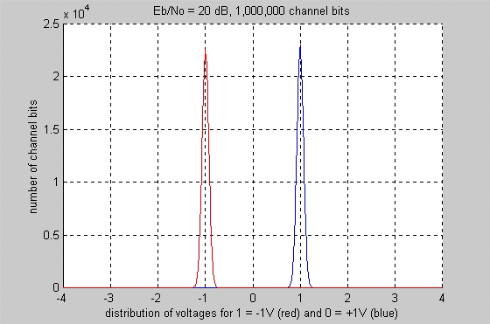
Coding Gain
Transmission voltages (signal to noise ratio SNR 20 dB).
No errors.

Slide 60
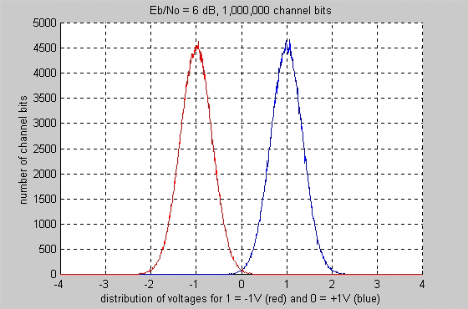
Coding Gain
Transmission voltages with Gaussian noise (SNR 6dB)
bit error rate (BER) of about 0.235%

Slide 61
Coding Gain
convolutional coding with Viterbi decoding can achieve a BER of less than 1 x 10⁻⁷ at the same SNR, 6 dB
r = ½, K = 3
Use 5db less power to achieve 1 x 10⁻⁷ BER than without coding
Coding uses twice as much (3dB) bandwidth
Coding gain: 5dB-3dB = 2dB less energy

Slide 62
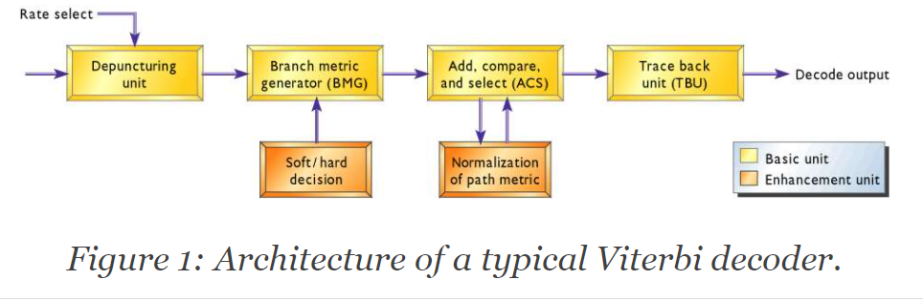
Viterbi decoder hardware

Slide 63
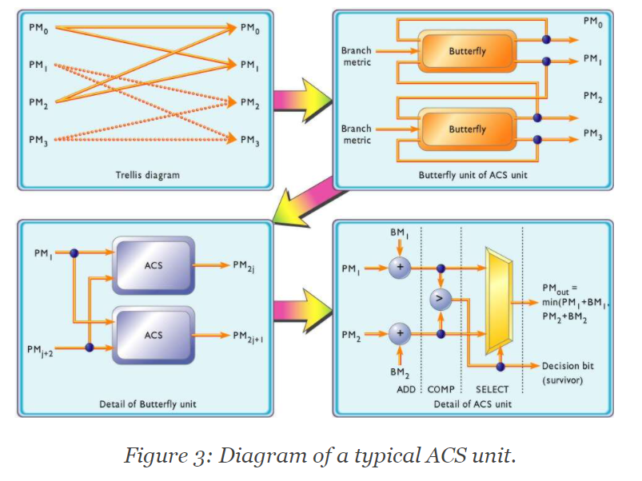
Inside the ACS ("secret sauce" of Viterbi)

Slide 64
Cool Viterbi Example
From Keith CHugg, USC, March 2017
Best insight-building discussion I have seen.
Objective: drive west to east coast of US
<750 mi/day
Figure of merit = distance (low score wins)
Array of 8 columns of 4 rows/states/nodes each
like 8 consecutive symbols

Slide 65

4 cities to choose from each day

Slide 66
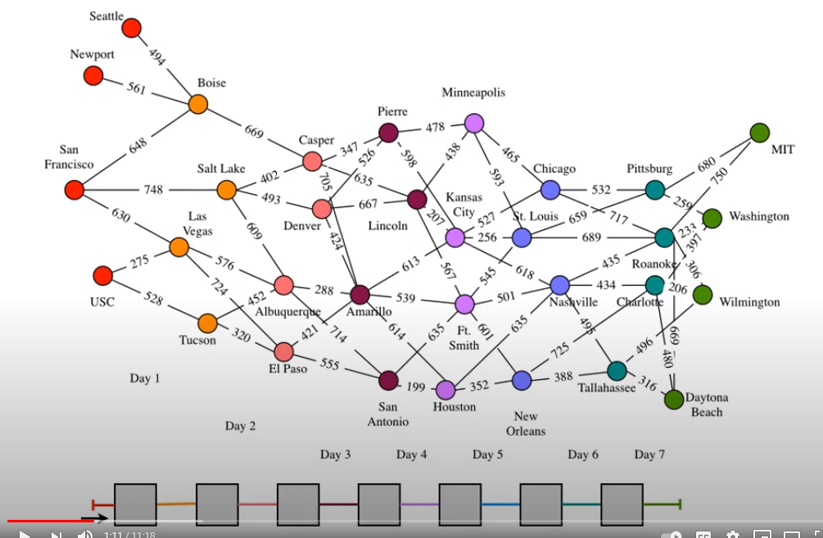
problem: lots of potential paths

Slide 67
Missing links make it a bit easier
If we were transmitting symbols from 2-sample states, we would have four possible states at each sample point in time, but we would also be able to go from any state to any other.
No real loss of generality in this example.
As with solving any complex problem, consider divide-and-conquer.
For each Day 2 node, what was the shortest distance from an available Day 1 node?

Slide 68
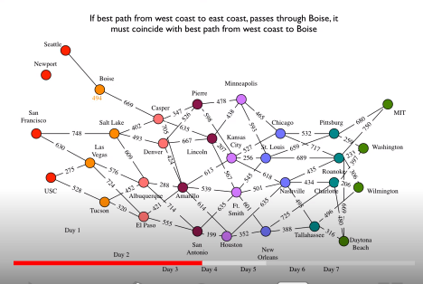
Start w/ day 2 -- shortest paths to get there

Slide 69

keep pruning

Slide 70
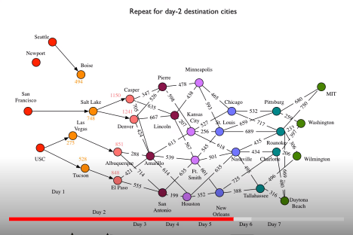
second pruning -- total paths to 3rd column

Slide 71
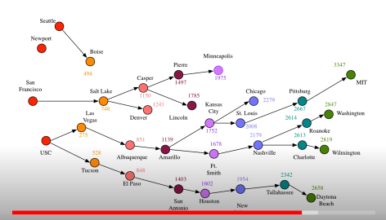
result

Slide 72
Conclusion so far
Have eliminated 3 of 4 starting states
Have eliminated 2 of 4 2nd states, 3rd state, 4th states
Still show 4 possible destinations
can pick the winner among these 4
Key is to eliminate long paths step by step
Note this model lets us start anywhere on west coast and end anywhere on east. If we constrain these endpoints, then we have only 6 sets of states in between.

Slide 73
Lookback
Identified shortest path to ANY state (City) on E Coast
Go backward to reconstruct the route and the cumulative distance
Eliminate options as early as possible
Store the winners as you go to facilitate traceback at end

Slide 74
How about genetic sequencing?
... or handwriting character recognition?
... or speech recognition?

Slide 75
HMM : Viterbi algorithm -­ - example
Start
0.5
0.5
H
A | 0.2
C | 0.3
G | 0.3
T | 0.2
0.5
L
A | 0.3
C | 0.2
G | 0.2
T | 0.3
0.5
0.6
0.4
Simple Hidden Markhov Model comprises 2 states, H (high GC content) and L (low GC content).
The model can find a region of coding (H) DNA from a given sequence.
Sources:
For the theory, see Durbin et al (1998);;
For the example, see Borodovsky & Ekisheva (2006), pp 80-­81

Slide 76
HMM : Viterbi algorithm -­
Start
0.5
0.5
H
A | 0.2
C | 0.3
G | 0.3
T | 0.2
0.5
L
A | 0.3
C | 0.2
G | 0.2
T | 0.3
0.5
0.6
0.4
Consider sequence S= GGCACTGAA
Several paths through the hidden states (H and L) lead to the given sequence S.
Example: P = LLHHHHLLL
The probability of the HMM to produce sequence S through the path P is: p = p_{L}(0) * p_{L}(G) * p_{LL} * p_{L}(G) * p_{LH} * p_{H}(C) * ...
= 0.5 * 0.2 * 0.6 * 0.2 * 0.4 * 0.3 * ...
= ...

Slide 77

Where have we seen A,T,G,C before?

Slide 78
HMM : Viterbi algorithm -­
Start
0.5
0.5
H
A | 0.2
C | 0.3
G | 0.3
T | 0.2
0.5
L
A | 0.3
C | 0.2
G | 0.2
T | 0.3
0.5
0.6
0.4
GGCACTGAA
Several paths through the hidden states (H and L) lead to the given sequence, but not with equal probability.
The Viterbi algorithm = dynamic programming that computes the most probable path. Similar to the dynamic programs used to align 2 sequences (i.e. Needleman-­Wunsch)
Source: Borodovsky & Ekisheva, 2006

Slide 79

HMM : Viterbi algorithm -
Start
Viterbi algorithm: principle
0.5
0.5
H
A | 0.2
C | 0.3
G | 0.3
T | 0.2
0.5
L
A | 0.3
C | 0.2
G | 0.2
T | 0.3
0.5
0.6
0.4
G G C A C T G A A
The probability of the most probable path ending in state k with observation "i" is
probability to observe element i in state l
probability of the most probable path ending at position x-­1 in state k with element j
probability of the transition from state l to state k

Slide 80
HMM : Viterbi algorithm -
Start
Viterbi algorithm: principle
0.5
0.5
H
A | 0.2
C | 0.3
G | 0.3
T | 0.2
0.5
L
A | 0.3
C | 0.2
G | 0.2
T | 0.3
0.5
0.6
0.4
G G C A C T G A A
The probability of the most probable path ending in state k with observation "i" is
Here, the probability of the most probable path ending in state H with observation "A" at the 4th position is:
We can thus compute recursively (from the first to the last element of our sequence) the probability of the most probable path.

Slide 81
HMM : Viterbi algorithm -
Start
-­1
-­1
H
A | -­2.322
C | -­1.737
G | -­1.737
T | -­2.322
-­1
L
A | -­1.737
C | -­2.322
G | -­2.322
T | -­1.737
-­1
-­0.737
-­1.322
Remark: convenient to use the log of the probabilities, rather than the probabilities themselves. This allows us to compute sums instead of products, which is more efficient and accurate.
We used here log₂(p). (This is also used in LDPC.)
Can do log lookup table for speed or precompute once.

Slide 82
HMM : Viterbi algorithm -
Start
-­1
-­1
H
A | -­2.322
C | -­1.737
G | -­1.737
T | -­2.322
-­1
L
A | -­1.737
C | -­2.322
G | -­2.322
T | -­1.737
-­1
-­0.737
-­1.322
GGCACTGAA
Probability (in log₂) that G at the first position was emitted by state H
p_{H}(G,1) = -­1 -­1.737 = -­2.737
Probability (in log₂) that G at the first position was emitted by state L
p_{L}(G,1) = -­1 -­2.322 = -­3.322

Slide 83
HMM : Viterbi algorithm
Start
-­1
-­1
H
A | -­2.322
C | -­1.737
G | -­1.737
T | -­2.322
-­1
L
A | -­1.737
C | -­2.322
G | -­2.322
T | -­1.737
-­1
-­0.737
-­1.322
GGCACTGAA
Probability (log₂) that G at the 2nd position was emitted by state H
p_{H}(G,2) = -­1.737 + max (p_{H}(G,1)+p_{HH}, p_{L}(G,1)+p_{LH})
= -­1.737 + max (-­2.737 -­1 , -­3.322 -­1.322)
= -­5.474 (obtained from p_{H}(G,1))
Probability (log₂) that G at the 2nd position was emitted by state L
p_{L}(G,2) = -­2.322 + max (p_{H}(G,1)+p_{HL}, p_{L}(G,1)+p_{LL})
= -­2.322 + max (-­2.737 -­1.322 , -­3.322 -­0.737)
= -­6.059 (obtained from p_{H}(G,1))

Slide 84
HMM : Viterbi algorithm
Start
-­1
-­1
H
A | -­2.322
C | -­1.737
G | -­1.737
T | -­2.322
-­1
L
A | -­1.737
C | -­2.322
G | -­2.322
T | -­1.737
-­1
-­0.737
-­1.322
GGCACTGAA
G
G
C
A
C
T
G
A
A
H
-­2.73
-­5.47
-­8.21
-­11.53
-­14.01
...
-­25.65
L -­3.32 -­6.06 -­8.79 -­10.94 -­14.01 ... -­24.49
We then compute iteratively the probabilities p_{H}(i,x) and p_{L}(i,x) that nucleotide i at position x was emitted by state H or L, respectively. The highest probability obtained for the nucleotide at the last position is the probability of the most probable path. This path can be retrieved by back-­tracking.

Slide 85
HMM : Viterbi algorithm -
Start
-­1
-­1
H
A | -­2.322
C | -­1.737
G | -­1.737
T | -­2.322
-­1
L
A | -­1.737
C | -­2.322
G | -­2.322
T | -­1.737
-­1
-­0.737
-­1.322
back-­tracking
(= finding the path which corresponds to the highest probability, -­24.49)
G A A
-­25.65
GGCACTGAA
G
G
C
A
C
T
H
-­2.73
-­5.47
-­8.21
-­11.53
-­14.01
...
L
-­3.32
-­6.06
-­8.79
-­10.94
-­14.01
...
-­24.49
The most probable path is:
HHHLLLLLL
Its probability is 2^{-­24.49} = 4.25E-­8 (remember that we used log₂(p))

Slide 86
HMM : Forward algorithm -­
Start
0.5
0.5
H
A | 0.2
C | 0.3
G | 0.3
T | 0.2
0.5
L
A | 0.3
C | 0.2
G | 0.2
T | 0.3
0.5
0.6
0.4
Consider now the sequence S= GGCA
What is the probability P(S) that this sequence S was generated by the HMM model?
This probability P(S) is given by the sum of the probabilities p_{i}(S) of each possible path that produces this sequence.
The probability P(S) can be computed by dynamical programming using either the so-­called Forward or the Backward algorithm.

Slide 87
HMM : Forward algorithm -
Start
Forward algorithm
0.5
0.5
H
A | 0.2
C | 0.3
G | 0.3
T | 0.2
0.5
L
A | 0.3
C | 0.2
G | 0.2
T | 0.3
0.5
0.6
0.4
Consider now the sequence S= GGCA
 | Start | G | G | C | A
H | 0 | 0.5*0.3=0.15
L | 0 | 0.5*0.2=0.1

Slide 88
HMM : Forward algorithm -­
Start
0.5
0.5
H
A | 0.2
C | 0.3
G | 0.3
T | 0.2
0.5
L
A | 0.3
C | 0.2
G | 0.2
T | 0.3
0.5
0.6
0.4
Consider now the sequence S= GGCA
 | Start | G |  | G |  | C | A
H | 0 | 0.5*0.3=0.15 |  | 0.15*0.5*0.3 + 0.1*0.4*0.3=0.0345
L | 0 | 0.5*0.2=0.1

Slide 89

HMM : Forward algorithm -­
Start
0.5
0.5
H
A | 0.2
C | 0.3
G | 0.3
T | 0.2
0.5
L
A | 0.3
C | 0.2
G | 0.2
T | 0.3
0.5
0.6
0.4
Consider now the sequence S= GGCA
 | Start | G | G | C | A
H | 0 | 0.5*0.3=0.15 | 0.15*0.5*0.3 + 0.1*0.4*0.3=0.0345
L | 0 | 0.5*0.2=0.1 | 0.1*0.6*0.2 + 0.15*0.5*0.2=0.027

Slide 90
HMM : Forward algorithm -­
Start
0.5
0.5
H
A | 0.2
C | 0.3
G | 0.3
T | 0.2
0.5
L
A | 0.3
C | 0.2
G | 0.2
T | 0.3
0.5
0.6
0.4
Consider now the sequence S= GGCA
 | Start | G | G |  | C |  | A
H | 0 | 0.5*0.3=0.15 | 0.15*0.5*0.3 + 0.1*0.4*0.3=0.0345 |  |  | ... + ...
L | 0 | 0.5*0.2=0.1 | 0.1*0.6*0.2 + 0.15*0.5*0.2=0.027 |  |  | ... + ...

Slide 91
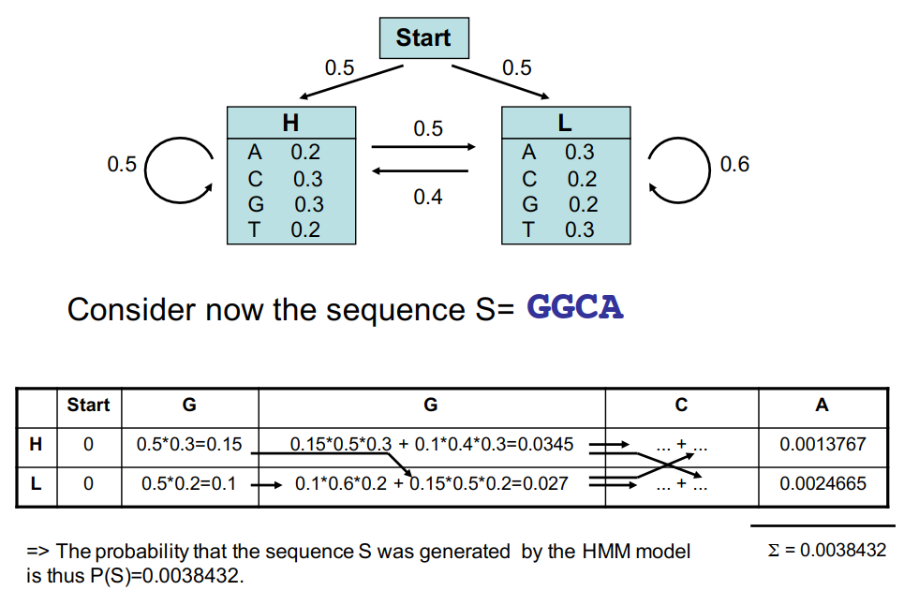

Slide 92
HMM : Forward algorithm -
Start
0.5
0.5
H
A | 0.2
C | 0.3
G | 0.3
T | 0.2
0.5
L
A | 0.3
C | 0.2
G | 0.2
T | 0.3
0.5
0.6
0.4
The probability that sequence S="GGCA" was generated by the HMM model is P_{HMM}(S) = 0.0038432.
To assess the significance of this value, we have to compare it to the probability that sequence S was generated by the background model (i.e. by chance).
Ex: If all nucleotides have the same probability, p_{bg}=0.25;; the probability to observe S by
chance is: P_{bg}(S) = p ⁴ = 0.25⁴ = 0.00396.
bg

Slide 93
Medical Disclaimer
Thus, for this particular example, it is likely that the sequence S does not match the HMM model (P_{bg} > P_{HMM}).
NB: Note that this model is very simple and does not reflect any biological motif. If fact both states H and L are characterized by probabilities close to the background probabilities, which makes the model not realistic and not suitable to detect specific motifs.

Slide 94
Summary -- Viterbi algorithm:
computes the most probable path (and its probability)
requires knowledge of the parameters of the HMM model and a particular output sequence
finds the state sequence that most likely generated that output sequence
finds a minimum Hamming distance over all possible state sequences
In sequence analysis, this method can be used for example to predict coding vs non-­coding sequences.
Often many state sequences can produce the same output sequence, but with different probabilities. One can calculate the probability for the HMM model to generate that output sequence by summing over all possible state sequences.
In sequence analysis, this method can predict the probability that a particular DNA region matches the HMM motif (i.e., was emitted by the HMM model). A HMM motif can represent a TF binding site for example.

Slide 95
Remarks
To create a HMM model (i.e. find the most likely set of state transition and output probabilities of each state), we need a set of (training) sequences, that does not need to be aligned.
No tractable algorithm is known for solving this problem exactly, but a local maximum likelihood can be derived efficiently using the Baum-­Welch algorithm or the Baldi-­Chauvin algorithm. The Baum-­Welch algorithm is an example of a forward-­backward algorithm, and is a special case of the Expectation-­maximization algorithm.
For more details: see Durbin et al (1998)
HMMER
The HUMMER3 package contains a set of programs (developed by S. Eddy) to build HMM models (from a set of aligned sequences) and to use HMM models (to align sequences or to find sequences in databases). These programs are available at the Mobyle plateform (http://mobyle.pasteur.fr/cgi-­bin/MobylePortal/portal.py)

Slide 96
References (from Fleming)
Some Books about Forward Error Correction
S. Lin and D. J. Costello, Error Control Coding. Englewood Cliffs, NJ: Prentice Hall, 1982.
A. M. Michelson and A. H. Levesque, Error Control Techniques for Digital Communication. New York: John Wiley & Sons, 1985.
W. W. Peterson and E. J. Weldon, Jr., Error Correcting Codes, 2 nd ed. Cambridge, MA: The MIT Press, 1972.
V. Pless, Introduction to the Theory of Error-Correcting Codes, 3rd ed. New York: John Wiley & Sons, 1998.
C. Schlegel and L. Perez, Trellis Coding. Piscataway, NJ: IEEE Press, 1997
S. B. Wicker, Error Control Systems for Digital Communication and Storage . Englewood Cliffs, NJ: Prentice Hall, 1995.

Slide 97
More References (from Fleming)
Some Papers about Convolutional Coding with Viterbi Decoding
For those interested in VLSI implementations of the Viterbi algorithm, I recommend the following paper and the papers to which it refers (and so on):
Lin, Ming-Bo, "New Path History Management Circuits for Viterbi Decoders," IEEE Transactions on Communications, vol. 48, October, 2000, pp. 1605-1608.
Other papers are:
G. D. Forney, Jr., "Convolutional Codes II: Maximum-Likelihood Decoding," Information Control, vol. 25, June, 1974, pp. 222-226.
K. S. Gilhousen et. al., "Coding Systems Study for High Data Rate Telemetry Links," Final Contract Report, N71-27786, Contract No. NAS2-6024, Linkabit Corporation, La Jolla, CA, 1971.
J. A. Heller and I. M. Jacobs, Viterbi Decoding for Satellite and Space Communications," IEEE Transactions on Communication Technology, vol. COM-19, October, 1971, pp. 835-848.
K. J. Larsen, "Short Convolutional Codes with Maximal Free Distance for Rates 1/2, 1/3, and 1/4," IEEE Transactions on Information Theory, vol. IT-19, May, 1973, pp. 371-372.
J. P. Odenwalder, "Optimum Decoding of Convolutional Codes," Ph. D. Dissertation, Department of Systems Sciences, School of Engineering and Applied Sciences, University of California at Los Angeles, 1970.
A. J. Viterbi, "Error Bounds for Convolutional Codes and an Asymptotically Optimum Decoding Algorithm," IEEE Transactions on Information Theory , vol. IT-13, April, 1967, pp. 260-269.

